Slide 1
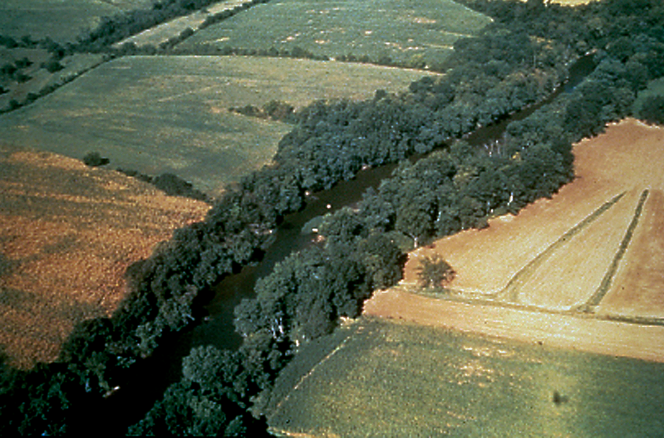
Measuring Forested Riparian Buffer Width with Lidar
A statistical comparison of 1m Lidar data against 1m state land cover data

Slide 2
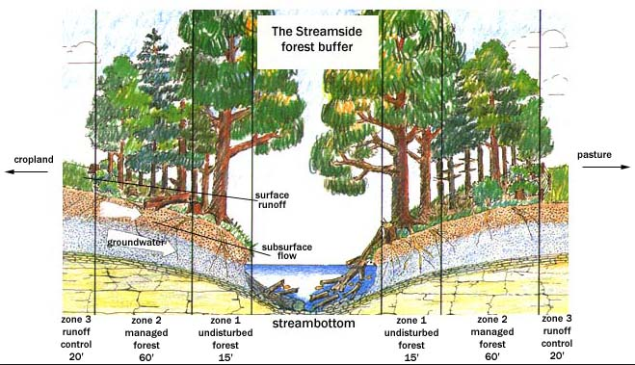
Background
Forested riparian buffers provide essential ecosystem services such as:
Bank stabilization
Water temperature control
Nitrogen & sediment removal
Flood mitigation
Wildlife habitat
http://www.dnr.state.md.us/forests/publications/sink.html
(Boesch & Greer, 2003)

Slide 3
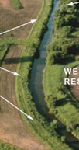
Background
Watershed monitoring programs require accurate information on land cover and land use change. (Goetz et al., 2004)
30m satellite data lacks the spatial resolution to assess FRB structure at critical scales. (Goetz et al., 2003)
1m IKONOS imagery and aerial photography have provided better results, but are economically prohibitive. (Goetz 2006. Lattin et al., 2004.)
30m x 30m
1m x 1m
http://www.mda.state.mn.us/protecting/conservation/practices/bufferforested.aspx

Slide 4
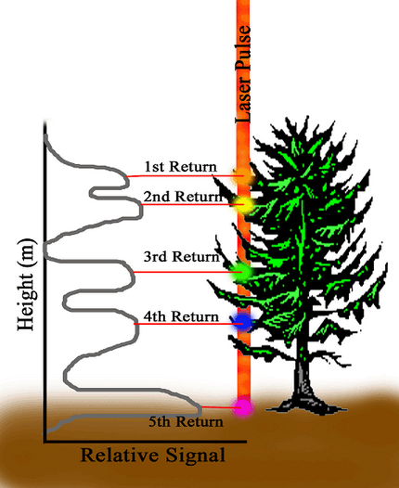
Background
LiDAR has been proven effective for mapping forest canopy cover and height at 1m scales (Dubayah & Drake, 2000).
Growing popularity has led to many states acquiring LiDAR data, allowing it to be a cost-effective method data set to use for mapping FRB width (Goetz 2006).
http://lidarcomm.com/id28.html

Slide 5
Research Questions
1. How does an assessment of Forested Riparian Buffer width differ between:
a) LiDAR derived canopy cover maps
b) State land use/land cover maps (based on aerial photography and human interpretation)
2. How is Forested Riparian Buffer width affected by adjoining land use type?
Does this vary significantly depending on the method used to determine buffer width?

Slide 6
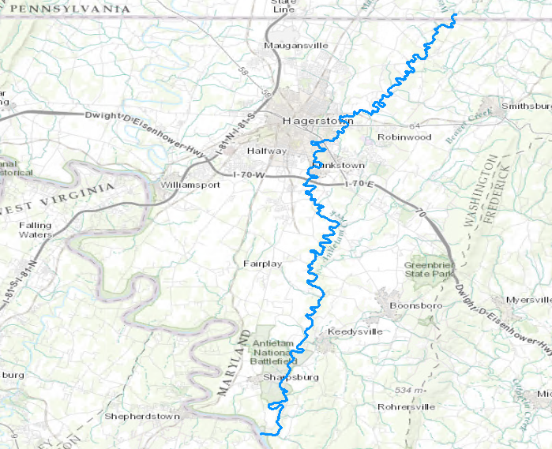
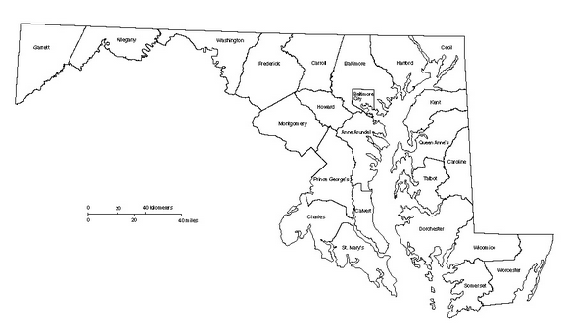
Study Area
Antietam Creek, Washington County, Maryland
Largely rural in nature, but…
Much nearby agriculture leading to sediment and nutrient run-off
Urban run-off from expanding Hagerstown region

Slide 7
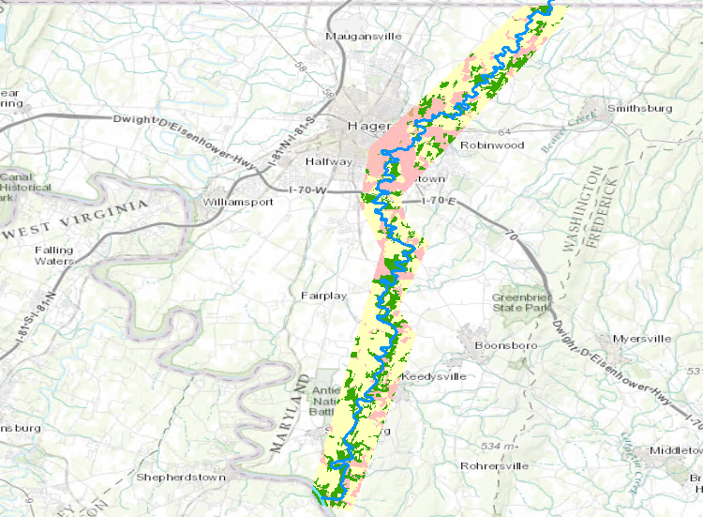
Study Area
Antietam Creek, Washington County, Maryland
Largely rural in nature, but…
Much nearby agriculture leading to sediment and nutrient run-off
Urban run-off from expanding Hagerstown region
Developed
Agriculture
Forested

Slide 8
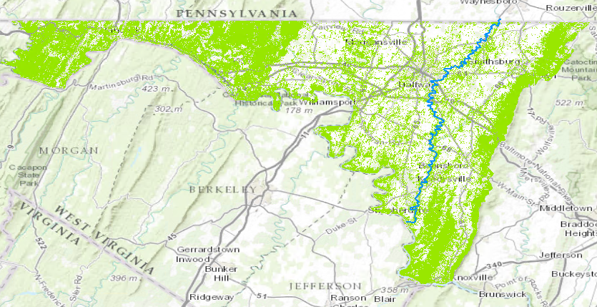
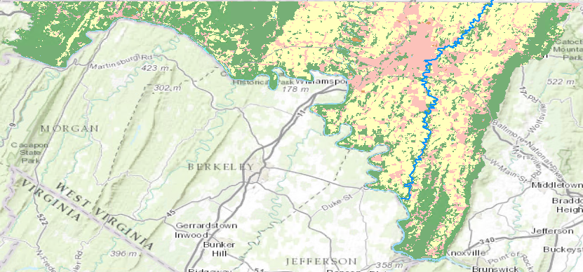
Data/Methods
1m LiDAR derived canopy cover map
2010 land use/land cover feature map
Developed
Agriculture
Canopy Cover
Forested
(Dubayah et al., 2012)
(Maryland Department of Planning, 2010)
Simplified to 3 land use/land cover types.
Rasterized in ArcMap at 1m resolution.
Antietam Creek Shapefile:
Derived from Open Street Map database.
Much more accurate than national or state level databases.

Slide 9
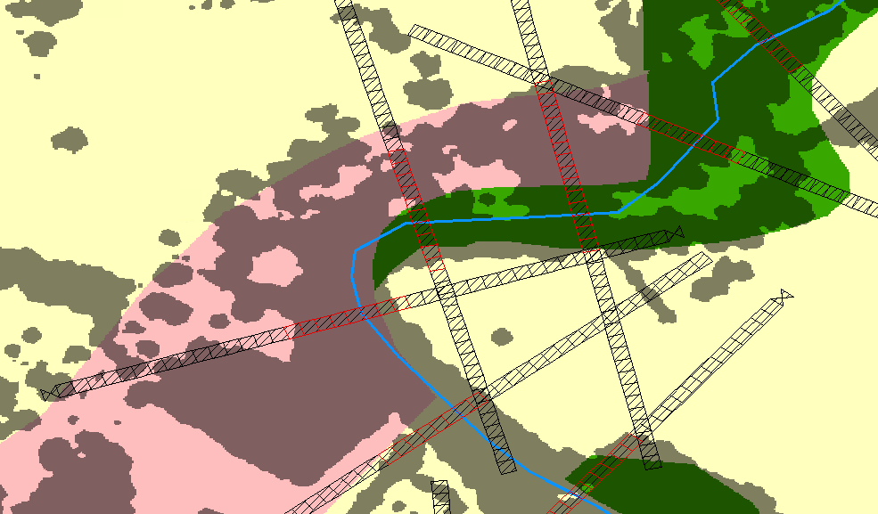
Methods
State LULC:
Developed
Agriculture
Forested
LiDAR Canopy Cover:
Forested
Calculated FRB
Transects:
10m x 10m windows
200m on either side
100m apart
1354 transects total
Transect layout following Wasser et al., 2015.

Slide 10
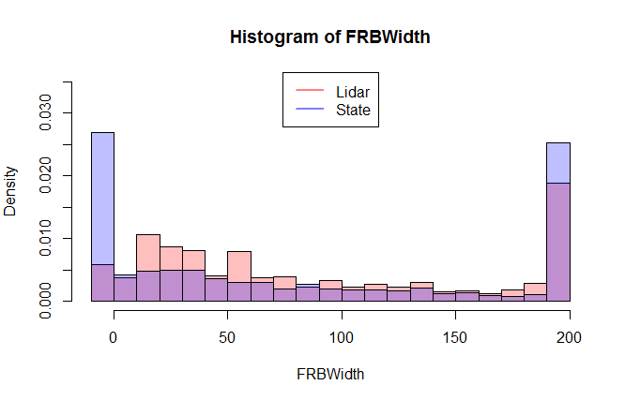
Results
1. How does buffer width calculation differ between input data sets?
 | Lidar | State AP
Mean | 91.87m | 85.17m
Standard Deviation | 70.42m | 80.95m
State LULC data does not capture buffer at critical 10m scale.
Lidar calculates a larger buffer at all levels, especially from 20m – 60m.

Slide 11
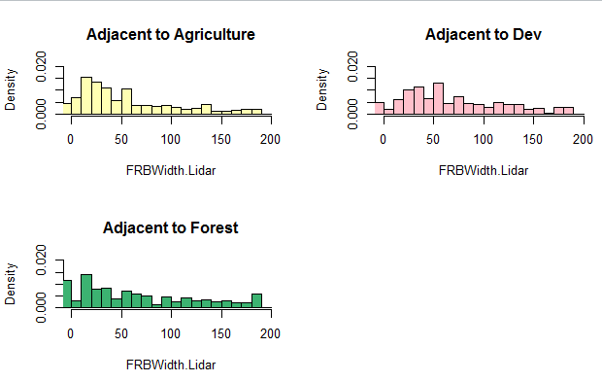
Results
2. How is FRB width affected by adjoining land use type (per input data)?
Smallest buffers (20m) are most likely to be adjacent to agricultural land.
Larger buffers (30m, 60m) are closer to developed lands.
Same dip at 50m buffer from general trend can be noted individually.
*
* Do not have an interpretation for Canopy Cover to Forest yet.

Slide 12
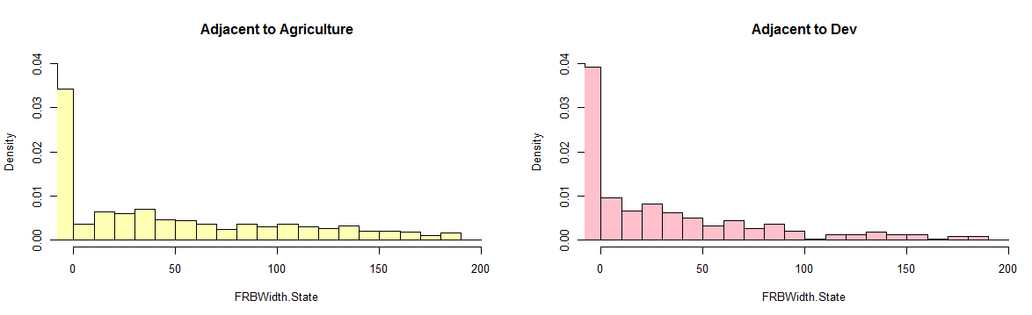
Results
2. How is FRB width affected by adjoining land use type (per input data)?
Less notable distinction between adjacent land cover types.
Dip at 50m is absent when calculated using State LULC data.

Slide 13
Discussion/Conclusion

Slide 14
References
Boesch D.F. and J. Greer (Editors), 2003. Chesapeake Futures: Choices for the 21st Century. Science and Technical Advisory Committee, Report 03-001 Chesapeake Research Consortium, Edgewater Maryland.
Dubayah, Ralph O., J.B.Drake. 2000. Lidar Remote Sensing for Forestry. Journal of Forestry.
Goetz, Scott J., R.K. Wright, A.J. Smith, E. Zinecker, E. Schaub. 2003. IKONOS imagery for resource management: Tree cover, impervious surfaces, and riparian buffer analyses in the mid-Atlantic region. Remote Sensing of the Environment.
Goetz, Scott J., C.A. Jantz, S.D. Prince, A.J. Smith, D.Varlyguin, R.K.Wright. 2004. Integrated Analysis of Ecosystem Interactions With Land Use Change: The Chesapeake Bay Watershed. Ecosystems and Land Use Change, Geophysical Monograph Series.
Goetz, Scott J. 2006. Remote Sensing of Riparian Buffers: Past Progress and Future Prospects. Journal of the American Water Resources Association.
Lattin, Peter D., P.J.Wigington, Jr., T.J.Moser, B.E.Peniston, D.R.Lindeman, D.R. Oetter. 2004. Influence of Remote Sensing Imagery Source on Quantification of Riparian Land Cover/Land Use. Journal of the American Water Resources Association.
Maryland Department of Planning. 2010. Land Use/ Land Cover for Maryland. http://planning.maryland.gov/OurWork/landUse.shtml
Wasser, Leah, L. Chasmer, R.Day, A.Taylor. 2015. Quantifying land use effects on forested riparian buffer vegetation structure using LiDAR data. Ecosphere.

